Slide 1

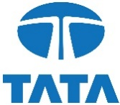

Tata Motors Market Analysis Report
Corporate Planning Analyst Interview
Name : Geeta Roy
Email ID : geeta24roy@gmail.com
LinkedIn : https://www.linkedin.com/in/geeta-roy-37a899225/

Slide 2
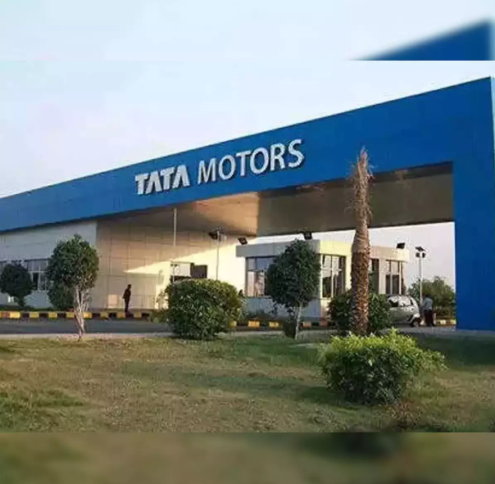
Introduction
Tata Motors was established in 1945 as Tata Engineering and Locomotive Co. Ltd. (TELCO), initially focusing on manufacturing locomotives and engineering products. Over the decades, Tata Motors has transformed itself into a global automotive giant. Starting with a collaboration with Daimler-Benz in 1954, the company entered the commercial vehicle market. Significant milestones include the launch of the Tata Indica in 1998, the acquisition of Jaguar and Land Rover in 2008, and the introduction of the Tata Nexon EV in 2021, among others.

Slide 3
Table of Contents:
Purpose of the Analysis
Objective: To provide a comprehensive market analysis of Tata Motors and its performance, focusing on key market trends, sales performance, competitive positioning, and future outlook.
Scope: This analysis covers the fiscal year 2021-22, highlighting significant changes compared to the previous fiscal year, and identifies strategic opportunities for growth and improvement.
Economy Overview : India
Market Overview
Automobile Industry Overview
Industry Analysis
Competitive Analysis
Conclusions and Recommendations

Slide 4
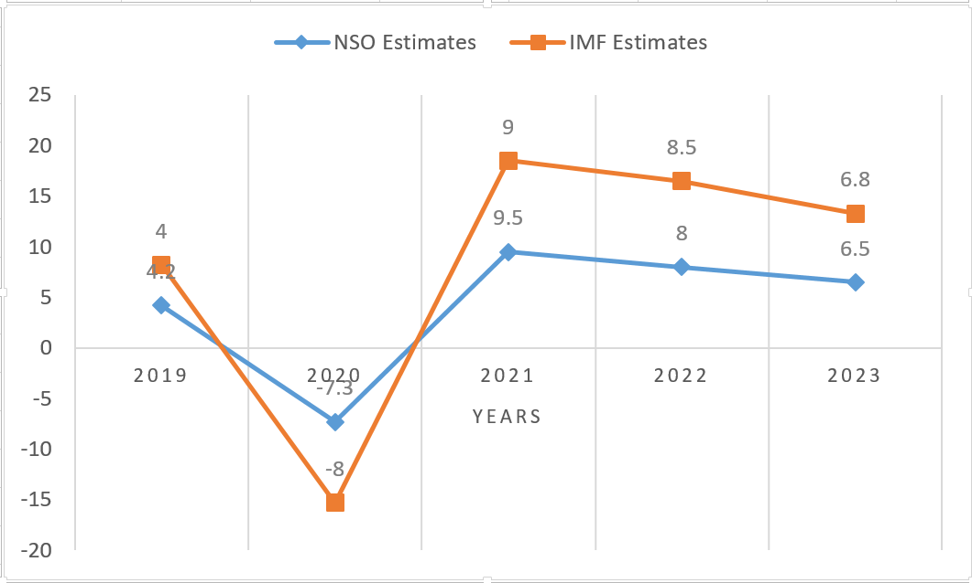
Economy Overview: India
Overview of the Indian Economy:
India's economy has been resilient, showing strong recovery post-pandemic.
Key sectors such as IT, manufacturing, and services have driven growth.
Government initiatives like 'Make in India' and 'Digital India' are fostering economic development.
Key Economic Indicators
Despite the contraction in 2020 due to the pandemic, India’s GDP growth rebounded strongly in subsequent years.
Inflation Rate: Managed within the target range, but subject to global commodity price fluctuations.
Unemployment Rate: Gradually decreasing with economic recovery and job creation initiatives.
Foreign Direct Investment (FDI): Steady inflow supporting various sectors.
Line graph of GDP growth rates (NSO and IMF estimates)
National Statistical Office (NSO) and International Monetary Fund (IMF) provide GDP growth estimates.

Slide 5
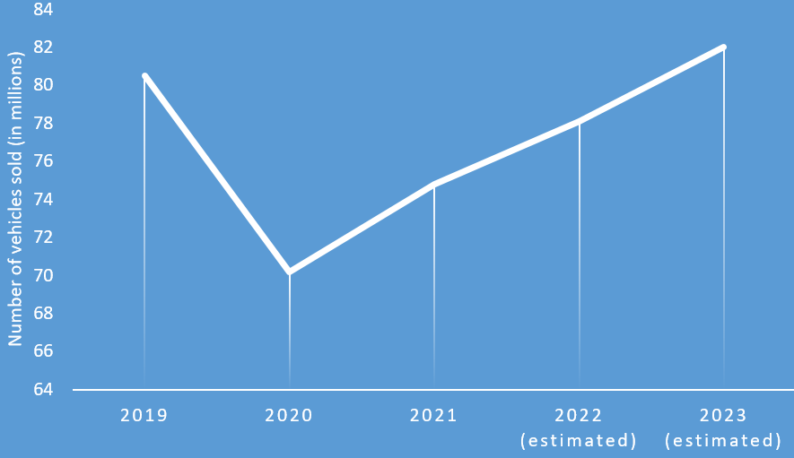
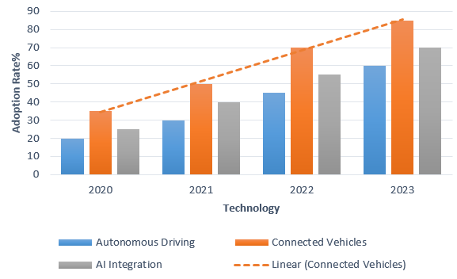
Market Overview
Global Automotive Sales (Post-Pandemic Recovery)
Adoption of Advanced Automotive Technologies
Key Highlights:
Global vehicle sales declined in 2020 due to the pandemic's impact on production and consumer spending.
A gradual recovery is observed in the following years, indicating a positive trend.
The bars will show the percentage increase in adoption rate for each technology year-over-year (2020, 2021, 2022, 2023).
Note: The data for 2023 is estimated based on industry forecasts.
The baseline year (2019) can be set at 100% to represent the starting point for comparison.
Data Source: EV Volumes

Slide 6
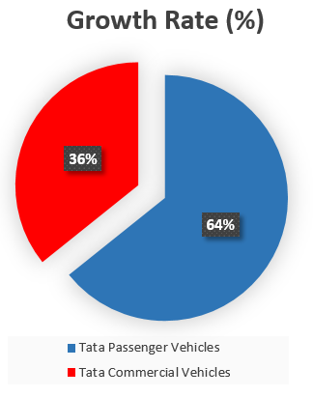
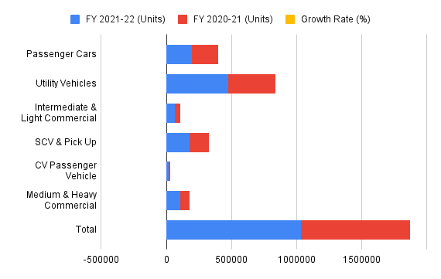
Automobile Industry Overview
Overview of the Indian Automobile Industry:
The Indian automobile industry is experiencing significant growth.
It includes a wide range of vehicles from two-wheelers to commercial vehicles.
The industry is a major contributor to the country's GDP and employment.
Total Vehicle Sales Worldwide (excluding China joint venture)
Passenger Car Sales Decline: Passenger car sales experienced a slight decline (-4.5%). This could be due to various factors such as a shift in consumer preference towards SUVs or the impact of COVID-19 on smaller car purchases.
Overall, Tata Motors' automotive operations experienced significant growth in FY 2021-22, with Tata Passenger Vehicles leading the surge.
Source: Management Discussion and Analysis Report, Tata Motors

Slide 7
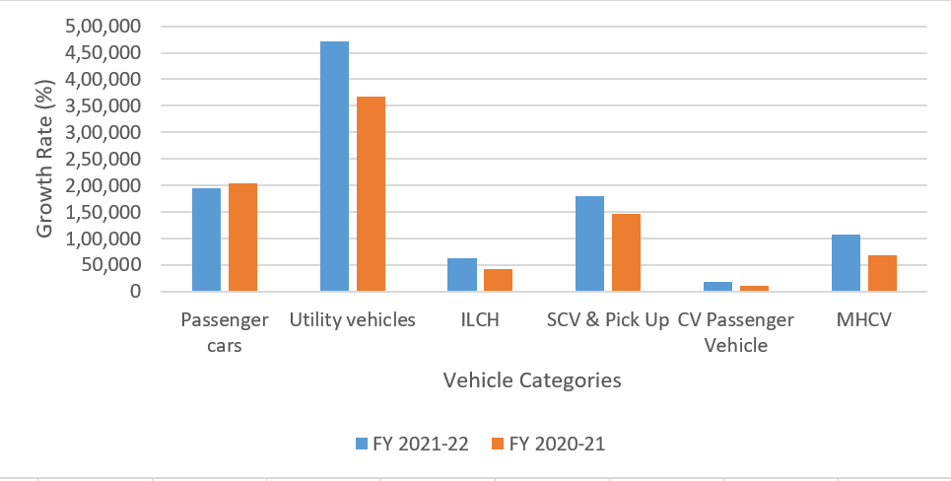
Industry Analysis
Growth Rates of Different Vehicle Categories:
Passenger Cars: Decreased by 4.5% from FY 2020-21 to FY 2021-22.
Utility Vehicles: Increased by 28.7% from FY 2020-21 to FY 2021-22.
Intermediate and Light Commercial Vehicles: Increased by 48.8% from FY 2020-21 to FY 2021-22.
SCV & Pick Up: Increased by 23.3% from FY 2020-21 to FY 2021-22.
CV Passenger Vehicle: Increased by 70.5% from FY 2020-21 to FY 2021-22.
Medium and Heavy Commercial Vehicles: Increased by 55.4% from FY 2020-21 to FY 2021-22.
Growth Rates of Different Vehicle Categories (FY 2021-22 vs. FY 2020-21)
Market Share Analysis:
Utility Vehicles: Dominated the market with 42.4% of total sales in FY 2021-22.
Passenger Cars: Contributed 17.4% of total sales in FY 2021-22.
Commercial Vehicles (combined): Accounted for a significant portion of the market, with notable growth across all segments.

Slide 8
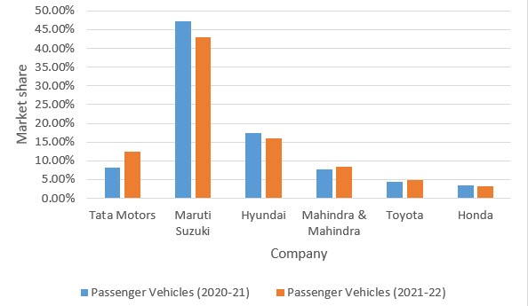


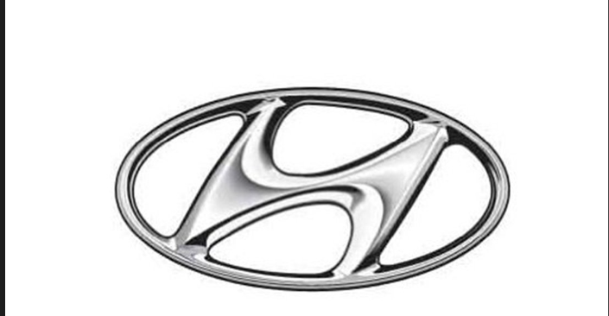
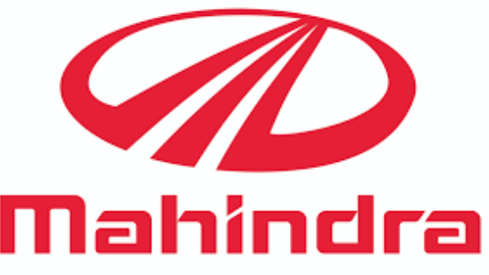
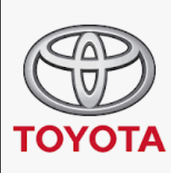
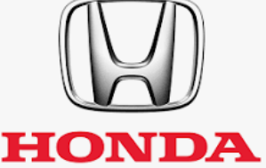
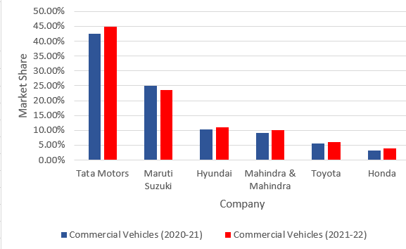
Competitive Analysis
Market Share Comparison of Key Players (FY 2020-21 vs. FY 2021-22)
Key Players in the Automobile Industry:
Tata Motors
Maruti Suzuki
Hyundai
Mahindra & Mahindra
Toyota
Honda
Market Share Comparison:
Tata Motors' share of the domestic market for passenger vehicles increased to 12.5% in FY 2021-22, up from 8.2% in FY 2020-21.
In the commercial vehicle market, Tata Motors maintained a dominant position with a 44.9% market share in FY 2021-22, up from 42.4% in FY 2020-21.
Source: Management Discussion and Analysis Report, Tata Motors

Slide 9
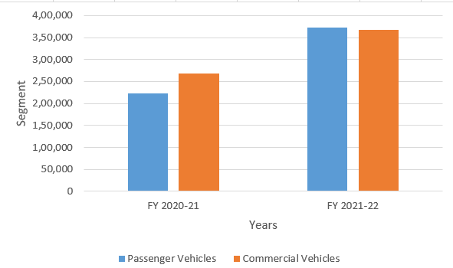
Sales Performance of Tata Motors
Sales Performance of Major Competitors:
Tata Passenger Vehicles: 372,157 units sold in FY 2021-22 (50.3% of total sales), compared to 222,638 units in FY 2020-21 (45.4% of total sales).
Tata Commercial Vehicles: 367,565 units sold in FY 2021-22 (49.7% of total sales), compared to 267,513 units in FY 2020-21 (54.6% of total sales).
Source: Management Discussion and Analysis Report, Tata Motors

Slide 10
Conclusions and Recommendations
Summary of Key Findings
Sales Performance:
The overall vehicle sales for Tata Motors in FY 2021-22 showed significant growth compared to the previous fiscal year, particularly in the utility vehicles and commercial vehicles segments.
Passenger cars experienced a slight decline, but the market share for utility vehicles and commercial vehicles increased substantially.
Market Trends:
There was a notable shift towards utility vehicles and electric vehicles, reflecting changing consumer preferences and increased focus on sustainability.
The commercial vehicles segment showed resilience, with medium and heavy commercial vehicles maintaining a strong market presence.
Future Outlook
Market Growth: The automotive market is expected to continue its recovery, with significant growth in the utility vehicles and electric vehicles segments.
Technological Advancements: Adoption of new technologies such as autonomous driving, connected vehicles, and advanced safety features will drive future market dynamics.
Regulatory Environment: Stay ahead of regulatory changes by investing in compliance and sustainability initiatives, ensuring readiness for stricter emission norms and safety regulations.

